Slide 1
CSE 246 Design & Analysis of Algorithms
Greedy Algorithms (Part 1)

Slide 2
Greedy Algorithm
Greedy algorithms make the choice that looks best at the moment.
This locally optimal choice may lead to a globally optimal solution (i.e. an optimal solution to the entire problem).
‹#›

Slide 3
When can we use Greedy algorithms?
We can use a greedy algorithm when the following are true:
The greedy choice property: A globally optimal solution can be arrived at by making a locally optimal (greedy) choice. E.g., choosing the alley with the least crowd at this moment
The optimal substructure property: The optimal solution contains within its optimal solutions to subproblems.
‹#›

Slide 4
Designing Greedy Algorithms
Cast the optimization problem as one for which:
we make a choice and are left with only one subproblem to solve
Prove the GREEDY CHOICE
that there is always an optimal solution to the original problem that makes the greedy choice
Prove the OPTIMAL SUBSTRUCTURE:
the greedy choice + an optimal solution to the resulting subproblem leads to an optimal solution of the whole problem
‹#›

Slide 5
Optimal Substructure
Find optimal soln.
Problem
Greedy Choice
Example - Always taking smaller time route providing the optimal time route from source to destination.
Find optimal soln.
Subproblem 1
Greedy Choice
Find optimal soln.
Subproblem 2
Remaining Problem
Greedy Choice
Find optimal soln.
Subproblem n

Slide 6
Example: Making Change
Instance: amount (in cents) to return to customer
Problem: do this using the fewest number of coins
Example:
Assume that we have an unlimited number of coins of various denominations:
1c (pennies), 5c (nickels), 10c (dimes), 25c (quarters), 1$ (loonies)
Objective: Pay out a given sum $5.64 with the smallest number of coins possible.
‹#›

Slide 7
The Coin Changing Problem
Assume that we have an unlimited number of coins of various denominations:
1c (pennies), 5c (nickels), 10c (dimes), 25c (quarters), 1$==100c (loonies)
Objective: Pay out a given sum S with the smallest number of coins possible.
The greedy coin changing algorithm:
This is a Θ(m) algorithm where m = number of denominations.
while S > 0 do
c := value of the largest coin no larger than S;
num := S / c;
pay out num coins of value c;
S := S - num*c;
‹#›

Slide 8
Example: Making Change
E.g.:
$5.64 = 1 + 1 + 1 + 1 + 1 + .25 + .25 + .10 + .01 + .01 + .01 +.01
Greedy Choice: In optimal Solution, we will always have k * P, P=maximum coin unit possible which can be taken, k = maximum can be taken. If it contradicts -> Solution Fails
Optimal Substructure Property: Lets, optimal solution is S= C1 * k1 + C2 * K2 +C3 * k3 where C1 > C2 > C3 and each are coin unit, Now a subproblem is S` = S - (C1 * k1). S`’s best solution has to be gained from (C2 * K2 +C3 * k3), Otherwise optimal substructure property fails.
‹#›

Slide 9
Making Change – A big problem
Example 2: Coins are valued $.30, $.20, $.05, $.01
Does not have greedy-choice property, since $.40 is best made with two $.20’s, but the greedy solution will pick three coins (which ones?)
‹#›

Slide 10
More examples
Euro Coins (in cents) : Supports Greedy prop.
1 , 2, 5, 10, 20, 50, 100, 200
{1, 3, 4} -> Not supports Greedy prop, ex: 6
How can you find if the greedy property is working,
Simulate some cases, find some contradiction that fails the greedy property.

Slide 11
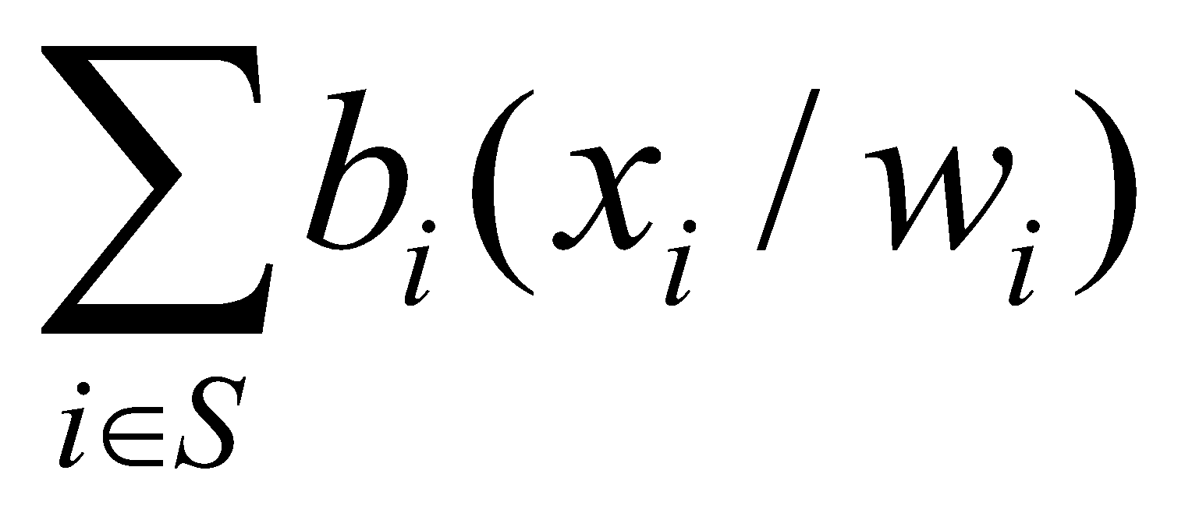
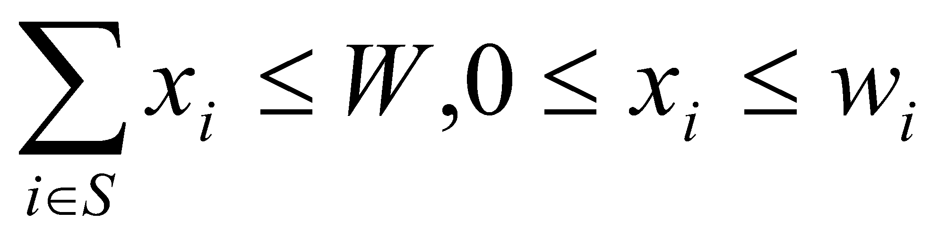
The Fractional Knapsack Problem
Given: A set S of n items, with each item i having
b_{i} - a positive benefit
w_{i} - a positive weight
Goal: Choose items with maximum total benefit but with weight at most W.
If we are allowed to take fractional amounts, then this is the fractional knapsack problem.
In this case, we let x_{i} denote the amount we take of item i
Objective: maximize
Constraint:
‹#›

Slide 12
Fractional Knapsack: Greedy Intuition
As we can take fractional amount
we can take whatever we want not contradicting the maximum weight of an element and maximum weight of the sack
to fill up a single unit of sack we should try to maximize the benefit gain

Slide 13


Example
Given: A set S of n items, with each item i having
b_{i} - a positive benefit
w_{i} - a positive weight
Goal: Choose items with maximum total benefit but with total weight at most W.
“knapsack”
Solution: P
1 ml of 5 50$
2 ml of 3 40$
6 ml of 4 30$
1 ml of 2 4$
Total Profit:124$
Items:
1
2
3
4
5
Weight:
4 ml
8 ml
2 ml
6 ml
1 ml
Benefit:
$12
$32
$40
$30
$50
10 ml
Value:
3
4
20
5
50
($ per ml)
‹#›

Slide 14
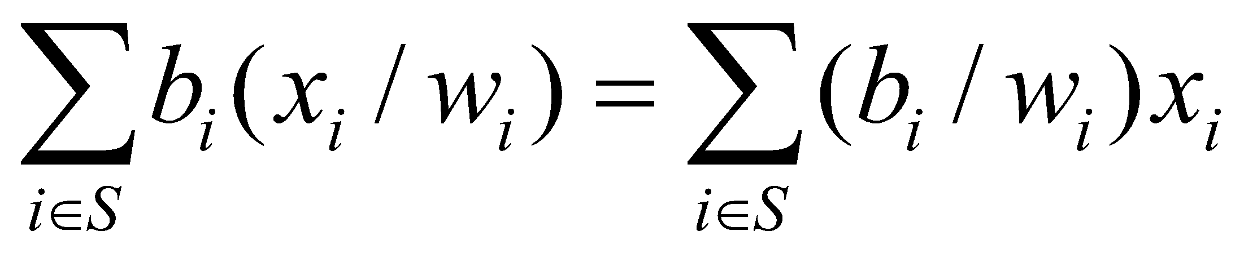
The Fractional Knapsack Algorithm
Greedy choice: Keep taking item with the highest value (benefit to weight ratio)
Since
Algorithm fractionalKnapsack(S, W)
Input: set S of items w/ benefit b_{i} and weight w_{i}; max. weight W
Output: amount x_{i} of each item i to maximize benefit w/ weight at most W
for each item i in S
x_{i} ← 0
v_{i} ← b_{i} / w_{i} {per unit benefit}
w ← 0 {total weight}
while w < W
remove item i with highest v_{i}
x_{i} ← min{w_{i} , W - w}
w ← w + min{w_{i} , W - w}
‹#›

Slide 15
The Fractional Knapsack Algorithm
Running time: Given a collection S of n items, such that each item i has a benefit b_{i} and weight w_{i}, we can construct a maximum-benefit subset of S, allowing for fractional amounts, that has a total weight W in O(nlogn) time.
Use heap-based priority queue to store S
Removing the item with the highest value takes O(logn) time
In the worst case, need to remove all items
‹#›

Slide 16
An Activity Selection Problem (Conference Scheduling Problem)
Input: A set of activities S = {a₁,…, a_{n}}
Each activity has a start time and a finish time
a_{i}=(s_{i}, f_{i})
Two activities are compatible if and only if their interval does not overlap
Output: a maximum-size subset of mutually compatible activities
‹#›

Slide 17
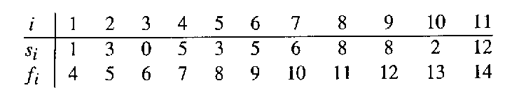
The Activity Selection Problem
Here are a set of start and finish times
What is the maximum number of activities that can be completed?
{a₃, a₉, a₁₁} can be completed
But so can {a₁, a₄, a_{8’} a₁₁} which is a larger set
But it is not unique, consider {a₂, a₄, a_{9’} a₁₁}
‹#›

Slide 18
The Activity Selection Problem
Input: list of time-intervals L
Output: a non-overlapping subset S of the intervals
Objective: maximize |S|
3,7
2,4
5,8
6,9
1,11
10,12
0,3
‹#›
Notes:
‹#›

Slide 19
The Activity Selection Problem
Input: list of time-intervals L
Output: a non-overlapping subset S of the intervals
Objective: maximize |S|
3,7
2,4
5,8
6,9
1,11
10,12
0,3
Answer = 3
‹#›
Notes:
‹#›

Slide 20
The Activity Selection Problem
Algorithm 1:
1. sort the activities by the starting time
2. pick the first activity a
3. remove all activities conflicting with a
4. repeat
‹#›
Notes:
‹#›

Slide 21
The Activity Selection Problem
Algorithm 1:
1. sort the activities by the starting time
2. pick the first activity “a”
3. remove all activities conflicting with “a”
4. repeat
‹#›
Notes:
‹#›

Slide 22
The Activity Selection Problem
Algorithm 1:
1. sort the activities by the starting time
2. pick the first activity “a”
3. remove all activities conflicting with “a”
4. repeat
‹#›
Notes:
‹#›

Slide 23
The Activity Selection Problem
Algorithm 2:
1. sort the activities by length
2. pick the shortest activity “a”
3. remove all activities conflicting with “a”
4. repeat
‹#›
Notes:
‹#›

Slide 24
The Activity Selection Problem
Algorithm 2:
1. sort the activities by length
2. pick the shortest activity “a”
3. remove all activities conflicting with “a”
4. repeat
‹#›
Notes:
‹#›

Slide 26
The Activity Selection Problem
Algorithm 2:
1. sort the activities by length
2. pick the shortest activity “a”
3. remove all activities conflicting with “a”
4. repeat
‹#›
Notes:
‹#›

Slide 27
The Activity Selection Problem
Algorithm 3:
1. sort the activities by ending time
2. pick the activity which ends first
3. remove all activities conflicting with a
4. repeat
‹#›
Notes:
‹#›

Slide 28
The Activity Selection Problem
Algorithm 3:
1. sort the activities by ending time
2. pick the activity which ends first
3. remove all activities conflicting with a
4. repeat
‹#›
Notes:
‹#›

Slide 29
The Activity Selection Problem
Algorithm 3:
1. sort the activities by ending time
2. pick the activity which ends first
3. remove all activities conflicting with a
4. repeat
‹#›
Notes:
‹#›

Slide 30
The Activity Selection Problem
Algorithm 3:
1. sort the activities by ending time
2. pick the activity which ends first
3. remove all activities conflicting with a
4. repeat
‹#›
Notes:
‹#›

Slide 31
The Activity Selection Problem
Algorithm 3:
1. sort the activities by ending time
2. pick the activity a which ends first
3. remove all activities conflicting with a
4. repeat
Theorem:
Algorithm 3 gives an optimal solution to
the activity selection problem.
‹#›
Notes:
‹#›

Slide 32
Activity Selection Algorithm
Idea: At each step, select the activity with the smallest finish time that is compatible with the activities already chosen.
Greedy-Activity-Selector(s, f)
sort the activities by ending time
n <− length[s]
A <− {1} {Automatically select first activity}
j <− 1 {Last activity selected so far}
for i <− 2 to n do
if si >= fj then
A <− A U {i} {Add activity i to the set}
j <− i {record last activity added}
return A
‹#›

Slide 33
The Activity Selection Problem
Here are a set of start and finish times
What is the maximum number of activities that can be completed?
{a₃, a₉, a₁₁} can be completed
But so can {a₁, a₄, a_{8’} a₁₁} which is a larger set
But it is not unique, consider {a₂, a₄, a_{9’} a₁₁}
‹#›

Slide 34

Interval Representation
‹#›

Slide 35
0 1 2 3 4 5 6 7 8 9 10 11 12 13 14 15
‹#›

Slide 36
0 1 2 3 4 5 6 7 8 9 10 11 12 13 14 15
‹#›

Slide 37
0 1 2 3 4 5 6 7 8 9 10 11 12 13 14 15
‹#›

Slide 38
0 1 2 3 4 5 6 7 8 9 10 11 12 13 14 15
‹#›

Slide 39
0 1 2 3 4 5 6 7 8 9 10 11 12 13 14 15
‹#›

Slide 40
0 1 2 3 4 5 6 7 8 9 10 11 12 13 14 15
‹#›

Slide 41
0 1 2 3 4 5 6 7 8 9 10 11 12 13 14 15
‹#›

Slide 42
Why this Algorithm is Optimal?
We will show that this algorithm uses the following properties
The problem has the optimal substructure property
The algorithm satisfies the greedy-choice property
Thus, it is Optimal
‹#›

Slide 43
Greedy-Choice Property
Show there is an optimal solution that begins with a greedy choice (with activity 1, which as the earliest finish time)
Suppose A ⊆ S in an optimal solution
Order the activities in A by finish time. The first activity in A is k
If k = 1, the schedule A begins with a greedy choice
If k ≠ 1, show that there is an optimal solution B to S that begins with the greedy choice, activity 1
Let B = A – {k} ∪ {1}
f₁ ≤ f_{k} 🡪 activities in B are disjoint (compatible)
B has the same number of activities as A
Thus, B is optimal
‹#›

Slide 44
Optimal Substructures
Once the greedy choice of activity 1 is made, the problem reduces to finding an optimal solution for the activity-selection problem over those activities in S that are compatible with activity 1
Optimal Substructure
If A is optimal to S, then A’ = A – {1} is optimal to S’={i ∈S: s_{i} ≥ f₁}
Why?
If we could find a solution B’ to S’ with more activities than A’, adding activity 1 to B’ would yield a solution B to S with more activities than A 🡺 contradicting the optimality of A
After each greedy choice is made, we are left with an optimization problem of the same form as the original problem
By induction on the number of choices made, making the greedy choice at every step produces an optimal solution
‹#›

Slide 45
Huffman Codes
Widely used technique for data compression
Assume the data to be a sequence of characters
Looking for an effective way of storing the data
Binary character code
Uniquely represents a character by a binary string
‹#›

Slide 46
Fixed-Length Codes
E.g.: Data file containing 100,000 characters
3 bits needed
a = 000, b = 001, c = 010, d = 011, e = 100, f = 101
Requires: 100,000 ⋅ 3 = 300,000 bits
 | a | b | c | d | e | f
Frequency (thousands) | 45 | 13 | 12 | 16 | 9 | 5
‹#›

Slide 47
Huffman Codes
Idea:
Use the frequencies of occurrence of characters to build a optimal way of representing each character
 | a | b | c | d | e | f
Frequency (thousands) | 45 | 13 | 12 | 16 | 9 | 5
‹#›

Slide 48
Variable-Length Codes
E.g.: Data file containing 100,000 characters
Assign short codewords to frequent characters and long codewords to infrequent characters
a = 0, b = 101, c = 100, d = 111, e = 1101, f = 1100
(45 ⋅ 1 + 13 ⋅ 3 + 12 ⋅ 3 + 16 ⋅ 3 + 9 ⋅ 4 + 5 ⋅ 4)⋅ 1,000
= 224,000 bits
 | a | b | c | d | e | f
Frequency (thousands) | 45 | 13 | 12 | 16 | 9 | 5
‹#›

Slide 49
Prefix Codes
Prefix codes:
Codes for which no codeword is also a prefix of some other codeword
Better name would be “prefix-free codes”
We can achieve optimal data compression using prefix codes
We will restrict our attention to prefix codes
‹#›

Slide 50
Encoding with Binary Character Codes
Encoding
Concatenate the codewords representing each character in the file
E.g.:
a = 0, b = 101, c = 100, d = 111, e = 1101, f = 1100
abc = 0 ⋅ 101 ⋅ 100 = 0101100
‹#›

Slide 51
Decoding with Binary Character Codes
Prefix codes simplify decoding
No codeword is a prefix of another ⇒ the codeword that begins an encoded file is unambiguous
Approach
Identify the initial codeword
Translate it back to the original character
Repeat the process on the remainder of the file
E.g.:
a = 0, b = 101, c = 100, d = 111, e = 1101, f = 1100
001011101 =
0
⋅ 0
⋅ 101
⋅ 1101
= aabe
‹#›

Slide 52
Prefix Code Representation
Binary tree whose leaves are the given characters
Binary codeword
the path from the root to the character, where 0 means “go to the left child” and 1 means “go to the right child”
Length of the codeword
Length of the path from root to the character leaf (depth of node)
100
100
0
1
0
1
86
14
a: 45
55
0
1
0
0
1
25
30
58
28
14
0
1
0
1
0
1
0
1
0
1
c: 12
b: 13
14
d: 16
a: 45
b: 13
c: 12
d: 16
e: 9
f: 5
0
1
f: 5
e: 9
‹#›

Slide 53
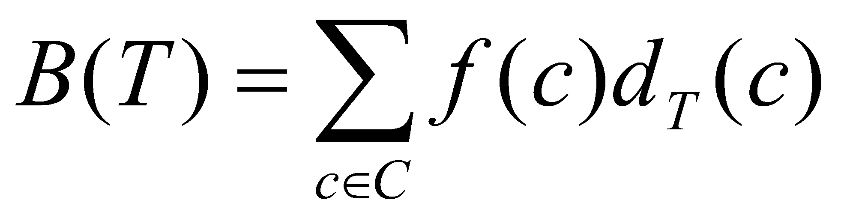
Optimal Codes
An optimal code is always represented by a full binary tree
Every non-leaf has two children
Fixed-length code is not optimal, variable-length is
How many bits are required to encode a file?
Let C be the alphabet of characters
Let f(c) be the frequency of character c
Let d_{T}(c) be the depth of c’s leaf in the tree T corresponding to a prefix code
the cost of tree T
‹#›

Slide 54
Constructing a Huffman Code
A greedy algorithm that constructs an optimal prefix code called a Huffman code
Assume that:
C is a set of n characters
Each character has a frequency f(c)
The tree T is built in a bottom up manner
Idea:
Start with a set of |C| leaves
At each step, merge the two least frequent objects: the frequency of the new node = sum of two frequencies
Use a min-priority queue Q, keyed on f to identify the two least frequent objects
f: 5
e: 9
c: 12
b: 13
d: 16
a: 45
‹#›

Slide 55
Example
f: 5
e: 9
c: 12
b: 13
d: 16
a: 45
c: 12
b: 13
14
d: 16
a: 45
0
1
f: 5
e: 9
14
d: 16
25
a: 45
25
30
a: 45
0
1
0
1
0
1
0
1
f: 5
e: 9
c: 12
b: 13
c: 12
b: 13
14
d: 16
0
1
f: 5
e: 9
55
0
100
1
a: 45
0
1
a: 45
55
25
30
0
1
0
1
0
1
25
30
c: 12
b: 13
14
d: 16
0
1
0
1
0
1
c: 12
b: 13
14
d: 16
f: 5
e: 9
0
1
‹#›
f: 5
e: 9

Slide 56
Building a Huffman Code
Alg.: HUFFMAN(C)
n ← ⎜C ⎜
Q ← C
for i ← 1 to n – 1
do allocate a new node z
left[z] ← x ← EXTRACT-MIN(Q)
right[z] ← y ← EXTRACT-MIN(Q)
f[z] ← f[x] + f[y]
INSERT (Q, z)
return EXTRACT-MIN(Q)
Running time: O(nlgn)
O(n)
O(nlgn)
‹#›

